Slide 1
Shark Attack
Mateo
Rathish
Rosi

Slide 2
Project Overview
Original dataset and Hypothesis
23 Columns and 6944 rows
Even Though in comparison in the excel table there were 8 more rows what we can see
There were hidden file like pdf, hreff, case number, and others unnamed
Only case number and original order seems could helpful for the analysis
We had possible hypothesis:
There is a relationship between the shark species with the severity of human injury. Also the time and the day (more people died at night for example)
The possibility of a complete cease of cases in the specific area after a given date (reason: measures could have been implemented after too many cases) So drastically decrease in cases in a specific zone/Area/state?
Certain activities, such as surfing or swimming, are associated with a higher risk of shark attacks.
Younger individuals are more likely to engage in high-risk activities such as surfing or swimming.
Male individuals are more frequently involved in high-risk activities compared to female individuals.
There is different shark behavior in the different habitat

Slide 3
Data Cleaning
Analyse irrelevant information (i.e. ‘source’, ‘date/year’, ‘name’)
Split the data cleaning into 3 (by columns)
Eliminate completely empty rows
Standardize the data type of the column
Find and search the best function to fill NA-values

Slide 4
Cleaning Challenges
If the data was categorical tried to have as few unique values as possible (location, injury)
If it is numeric, keep the format
Make relation to fill empty columns or rows
I.e. for unknown counties, we took the most common country.

Slide 5
Exploratory Data Analysis
Using pivot function to get descriptive output
import matplotlib.pyplot as plt to get visual output

Slide 6
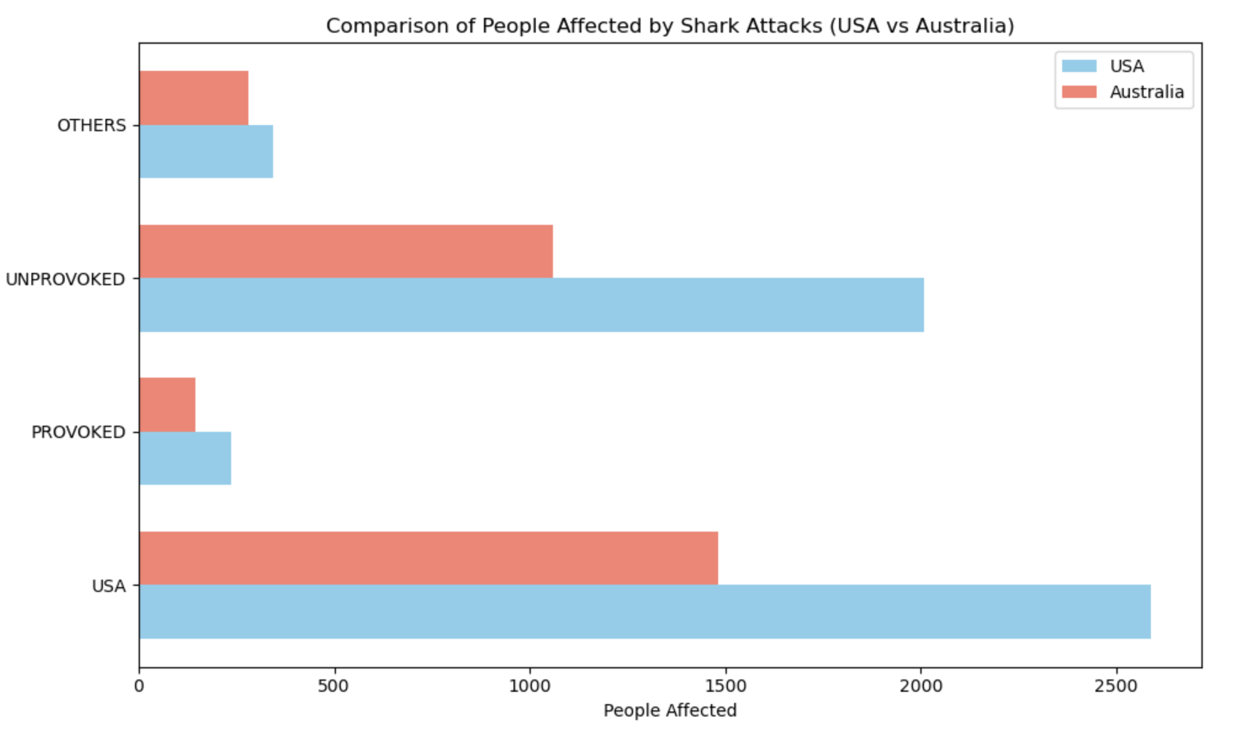

Slide 7
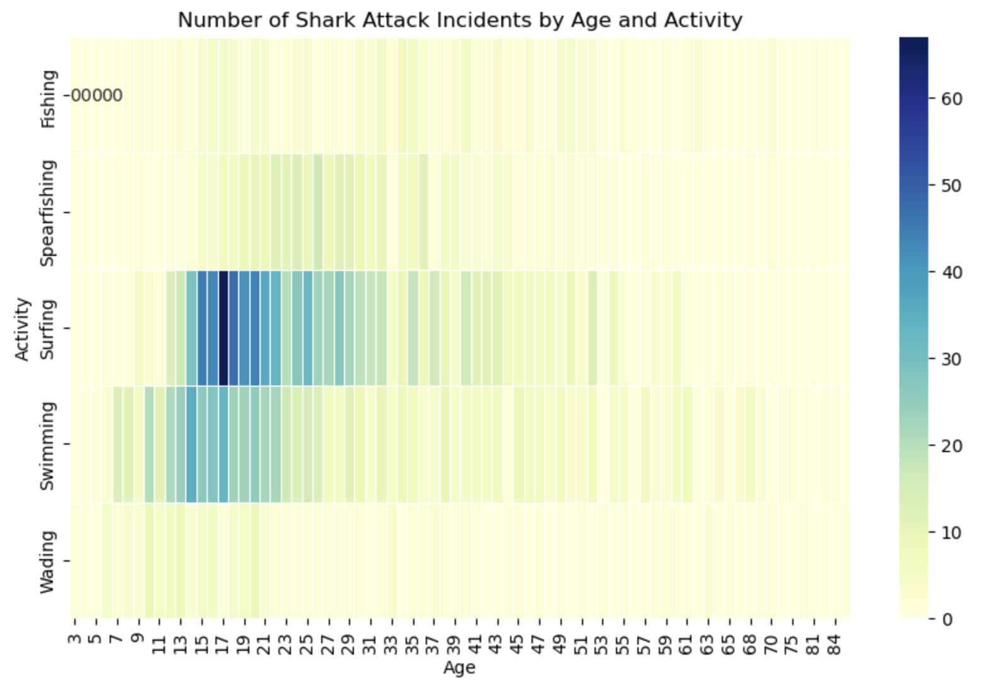

Slide 8
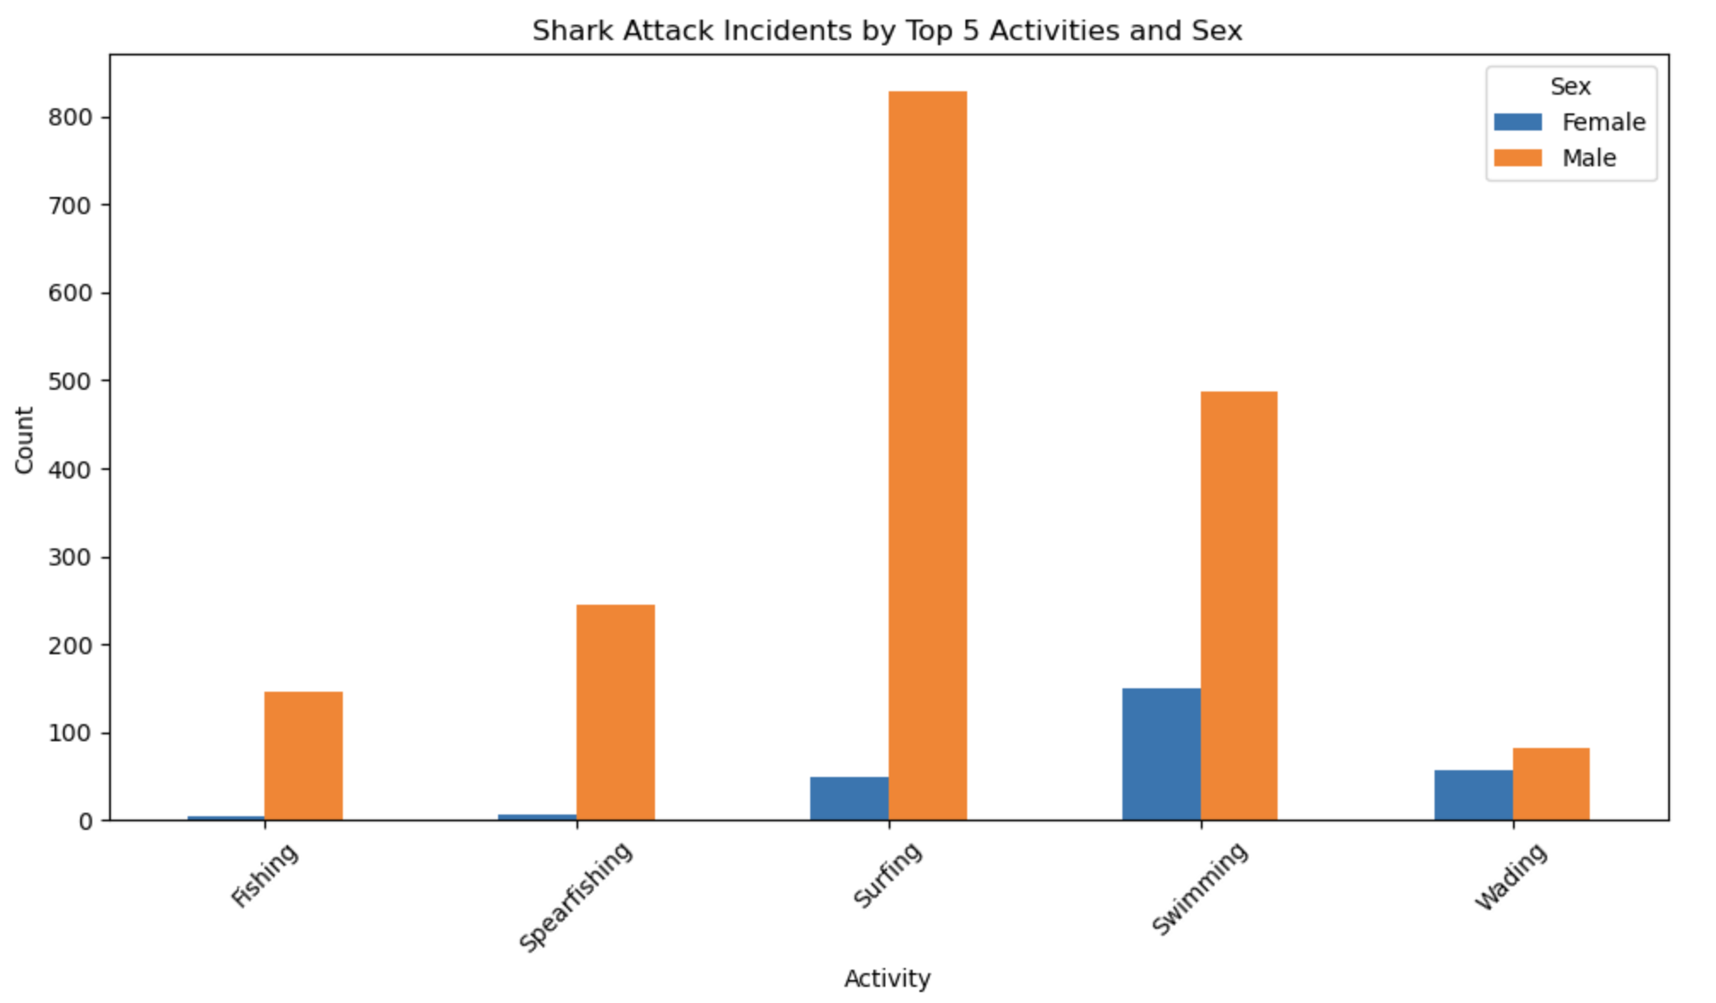

Slide 9
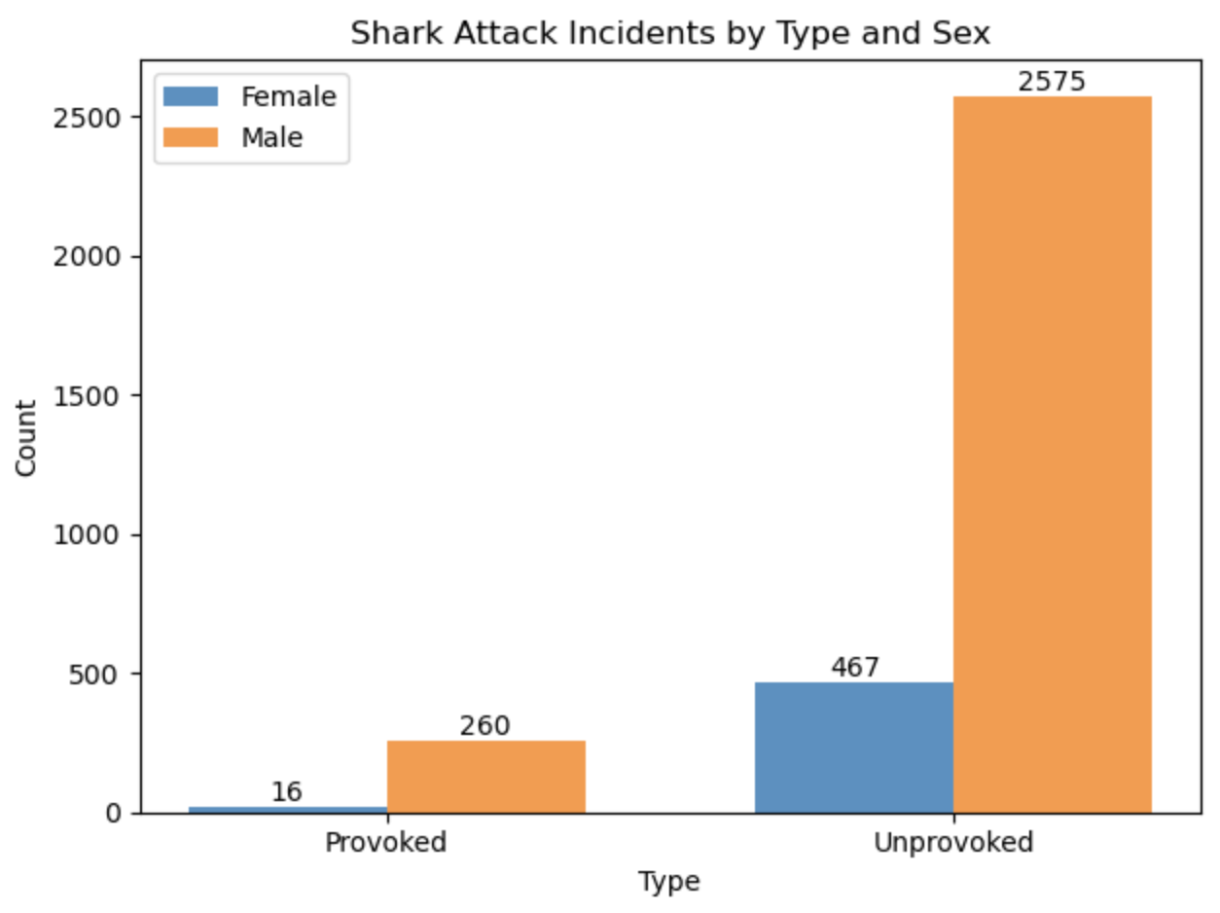

Slide 10
Major Obstacles
Cleaning
Dividing the task
Time and Resource
Plotting the data
Merging the data

Slide 12
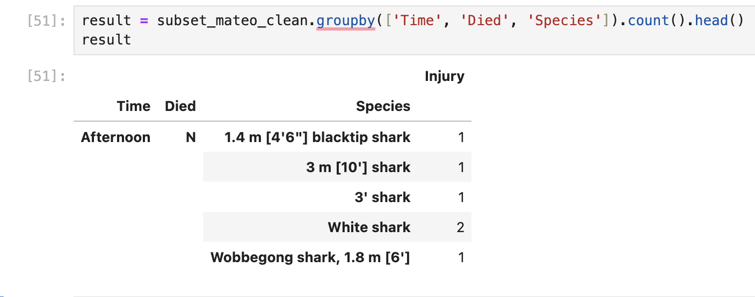
Fail example

